Slide 1

LONER MOBILE,
LONER DUO
&
SOS BUTTON

Slide 2
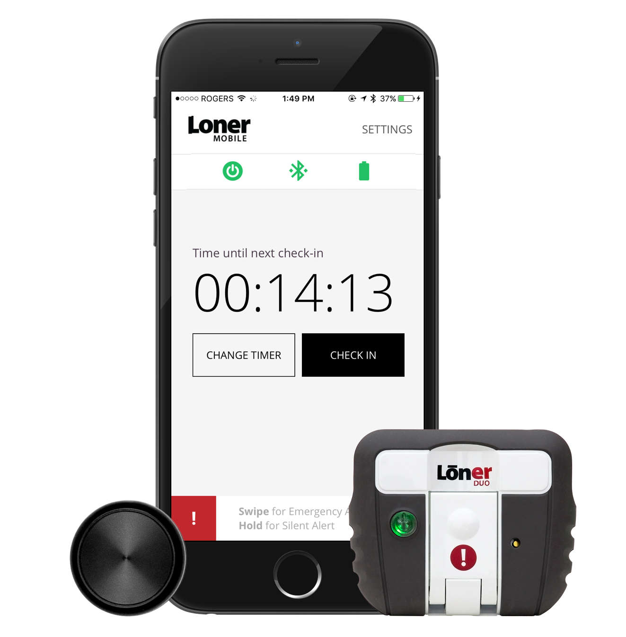
LONER MOBILE & LONER DUO
Loner Mobile provides a convenient way to call for help and check-in using your smartphone, allowing monitoring personnel to pin-point emergency response to your location.
Loner Duo and SOS Button are person-worn devices that detect motion-related incidents and have the capability of calling for help when a smartphone isn’t in reach.
Paired together using low-power Bluetooth® smart technology, these devices are able to provide the rigorous safety monitoring features exhibited by other devices from Blackline Safety.

Slide 3
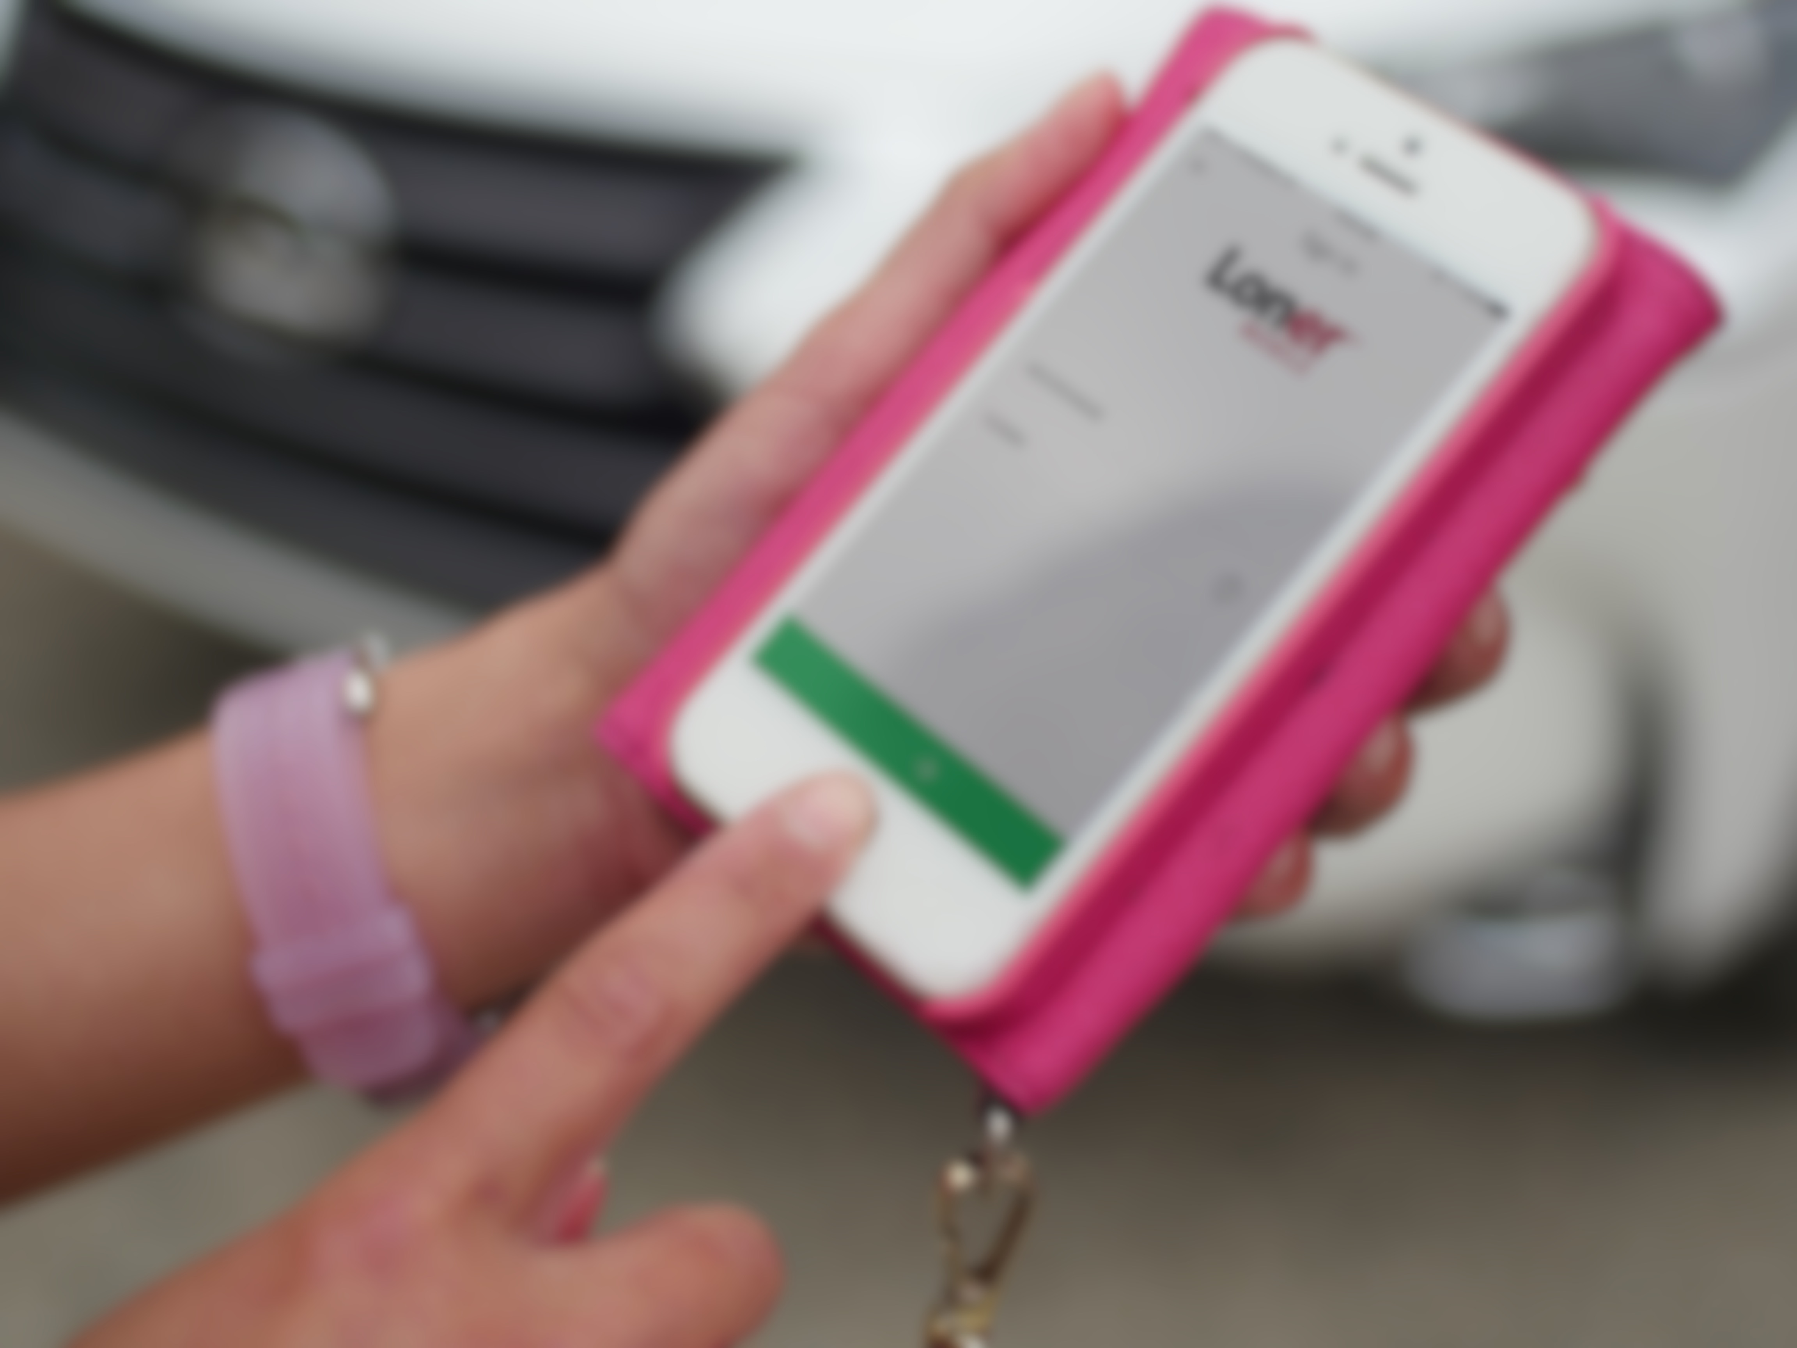
GETTING STARTED

Slide 4
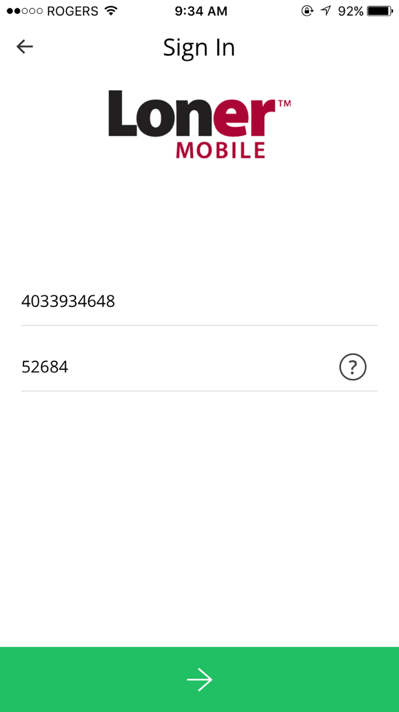

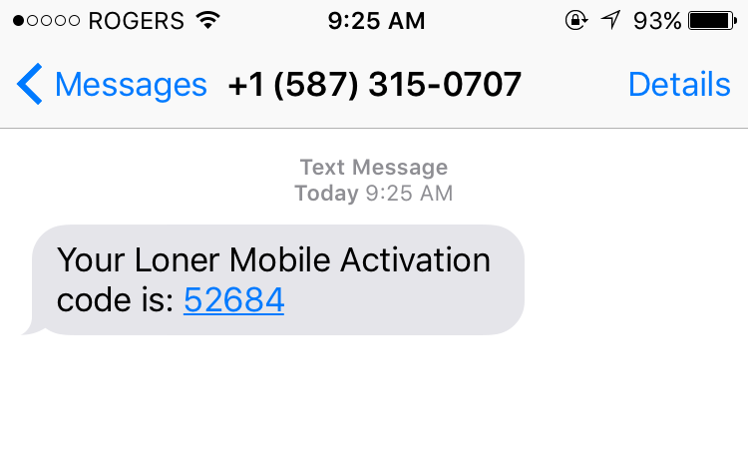
GETTING STARTED
1. Download Loner Mobile from your app store
2. Enter your phone number + activation code
Your activation code will be texted to you. If you haven’t received an activation code, contact your supervisor or our Customer Care team.

Slide 5
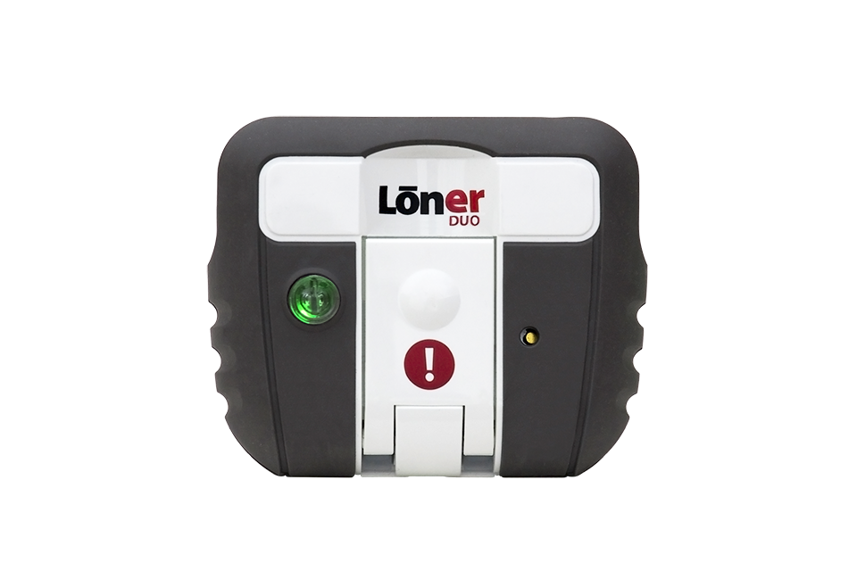
LONER DUO COMPONENTS
Alarm lights
SureSafe™ monitoring light and power button
SOS Latch
Charging light
Charge clip
Charging tips:
Fully charged in approximately 2 hours.
Battery run time of more than 12 hours.
Keep your Loner Duo continually charging when not in use. The battery loses power even when off.
Charge cable

Slide 6

SOS BUTTON COMPONENTS
Connectivity and alarm lights
Button
Changing batteries:
Uses CR2032 watch battery.
Twist the front and back pieces of the button in opposite directions to open.
If you have difficulty changing the batteries, you can take them to a watch repair center.
SOS Button can remain powered on continuously, and depending on usage, will last 2-3 months.

Slide 7
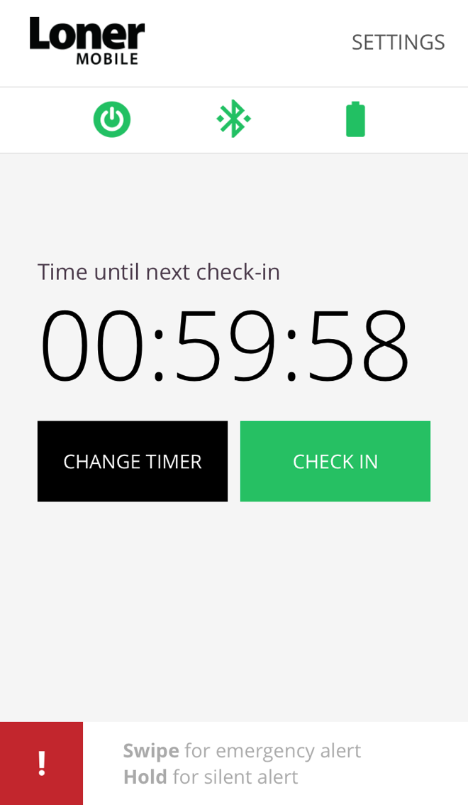
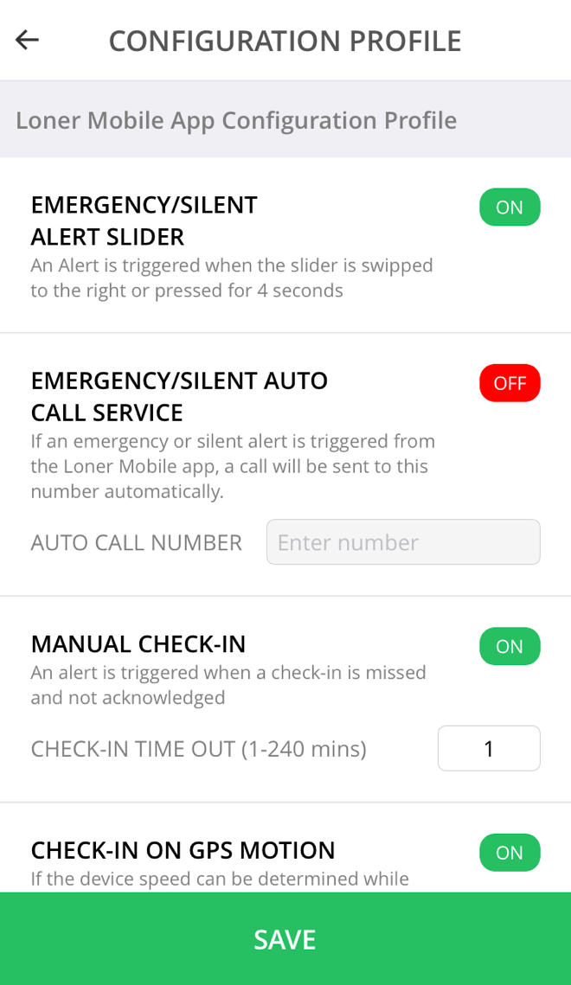
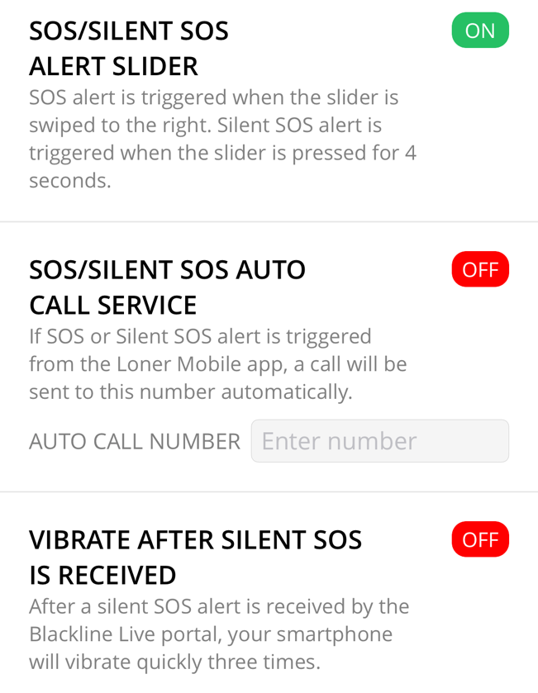

LONER MOBILE COMPONENTS – WITH EDIT PERMISSIONS
View settings
Start/stop monitoring
Alert title
Bluetooth connection
Bluetooth battery level
Alert description
Check in timer
Toggled on/off
Customize timer
Custom setting
Check-in button
Select to save and go back to the main screen
SOS slider
Main Screen
Configuration Profile
Your configuration profile can only be viewed (not edited) when monitoring

Slide 8
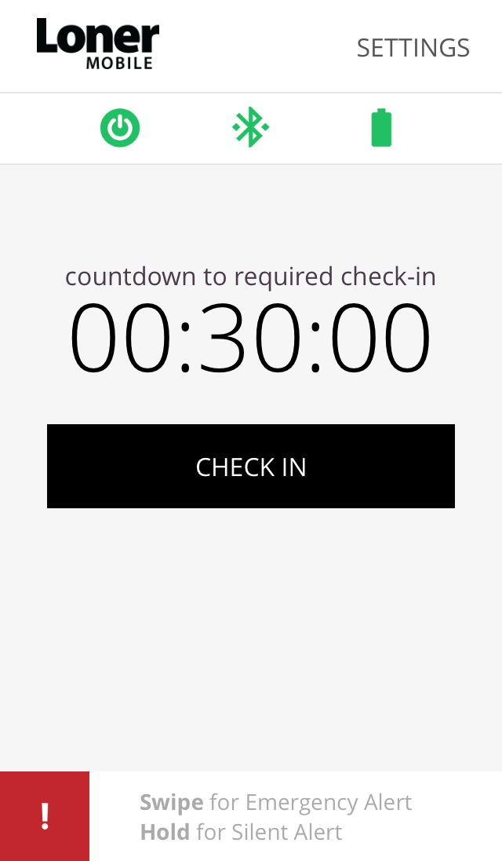
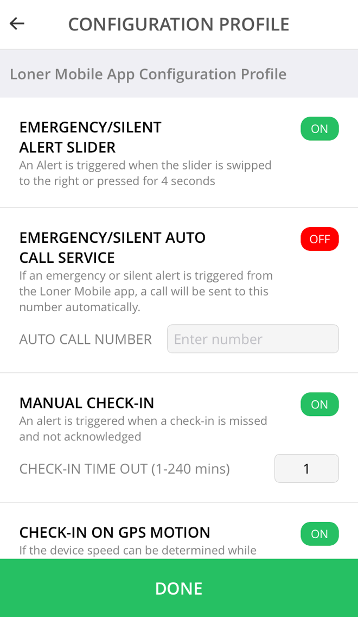
LONER MOBILE COMPONENTS – WITHOUT EDIT PERMISSIONS
View settings
Start/stop monitoring
Alert title
Bluetooth connection
Bluetooth battery level
Alert description
Check in timer
Toggled on/off
Check-in button
Custom setting
SOS slider
Select to go back to the main screen
Main Screen
Configuration Profile
Here you can view your configuration settings

Slide 9
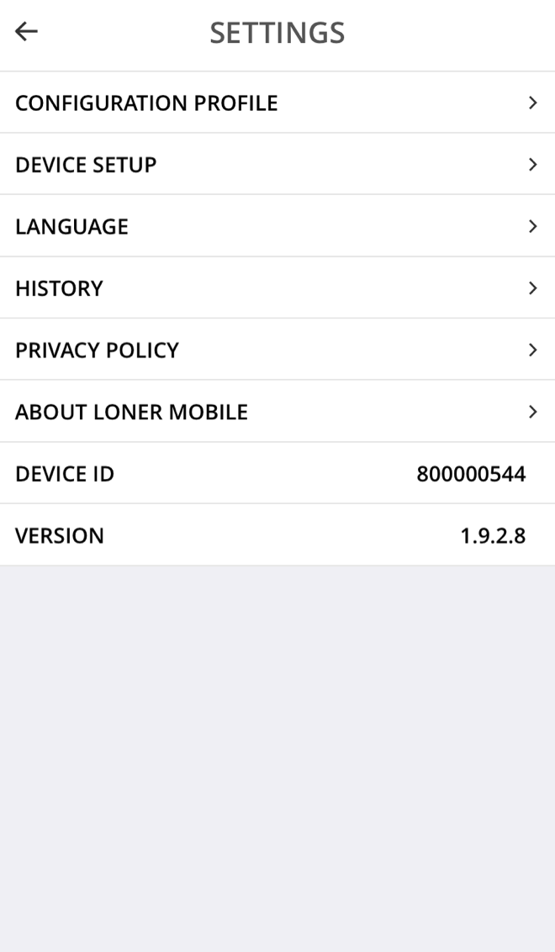
LONER MOBILE SETTINGS
View/edit configuration profile
Pair a Bluetooth device
Change Loner Mobile’s language
View device history
View Blackline’s privacy policy
Your unit ID
Your app version
Settings Page

Slide 10
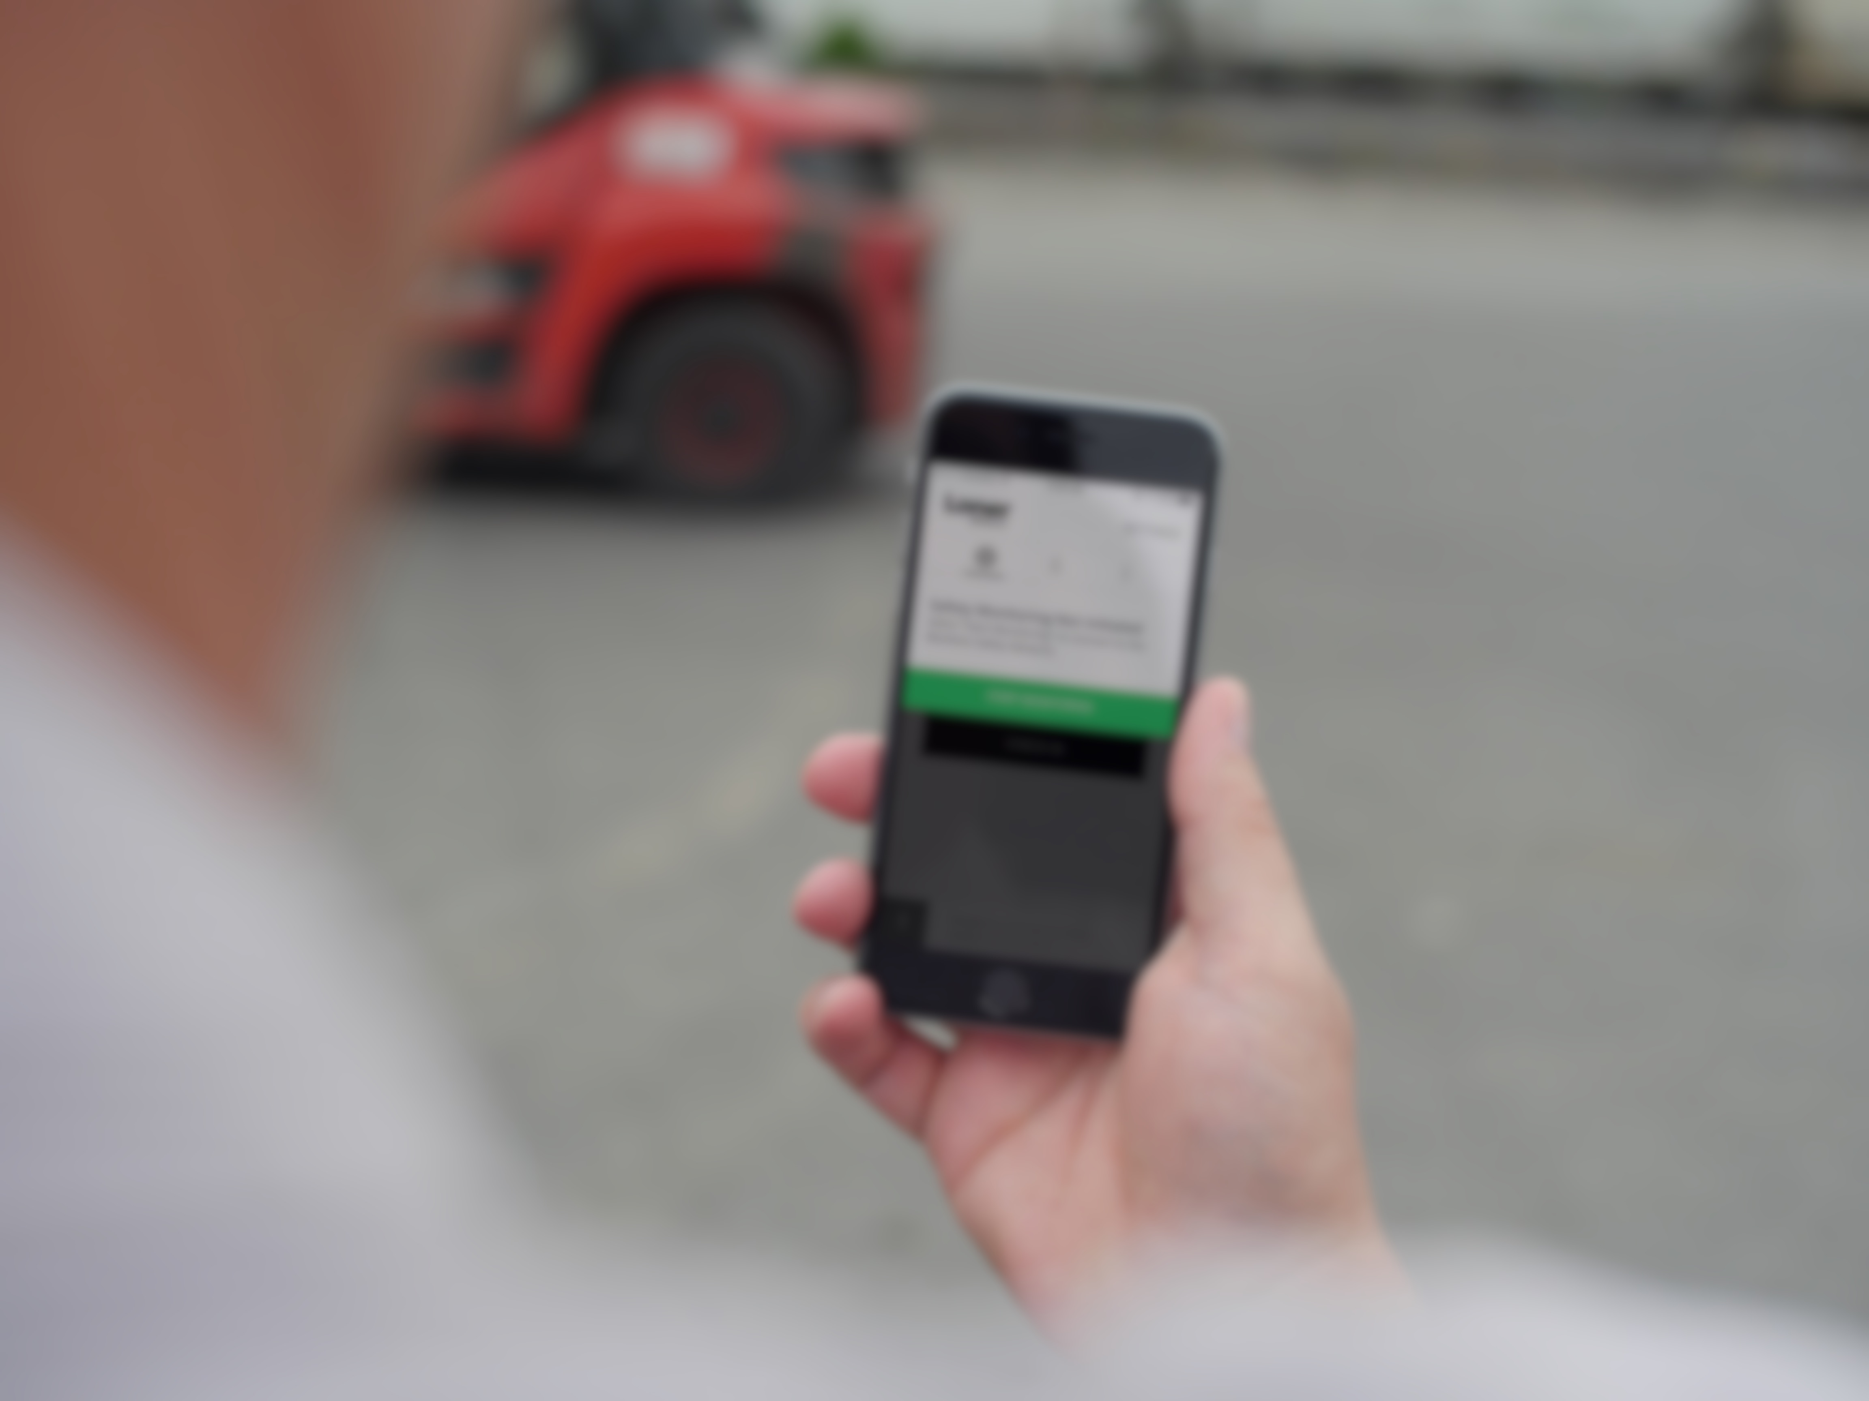
STARTING YOUR SHIFT

Slide 11


TURNING ON ACCESSORIES
Loner Duo
SOS Button
Press the power button
The green SureSafe light will blink until it is paired with the Loner Mobile app
Hold button for 10 seconds
Depending on your audio and visual settings, SOS button will chirp once and blink green every 10 seconds until paired

Slide 12
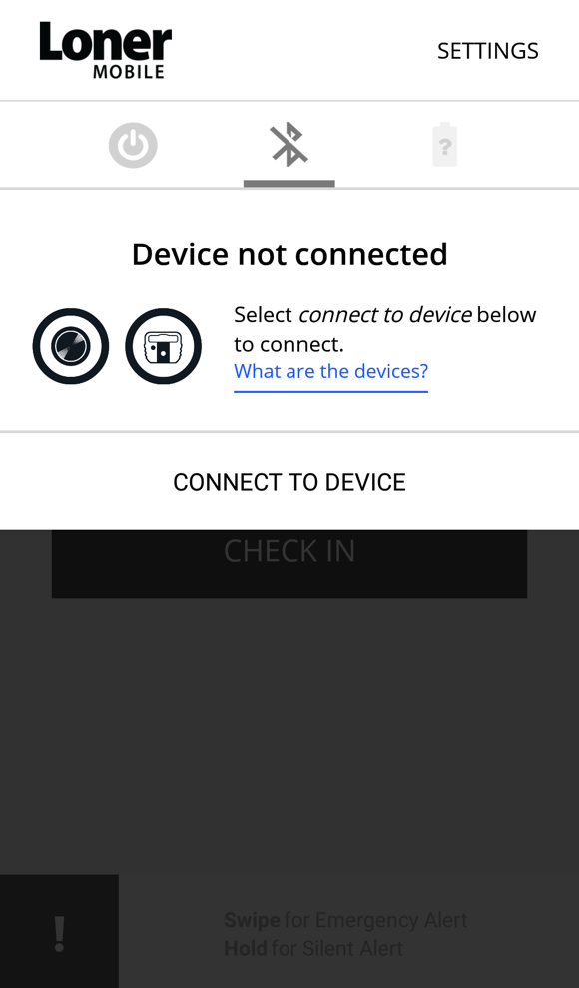
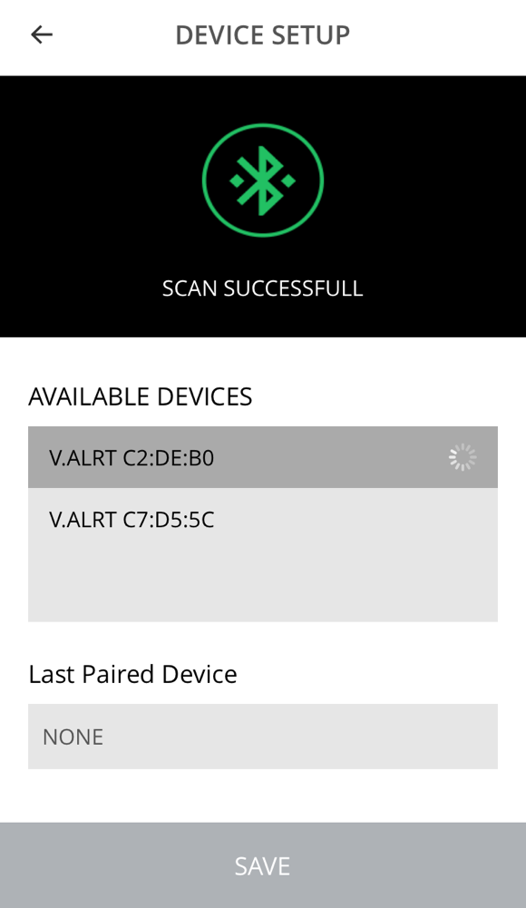
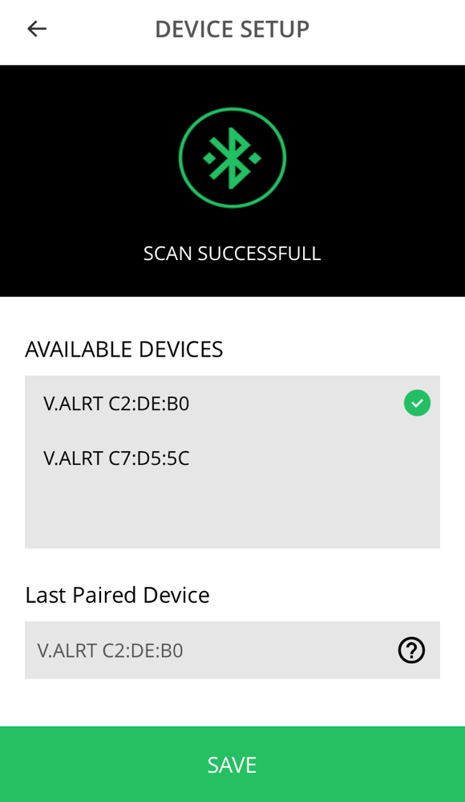
PAIRING ACCESSORIES TO LONER MOBILE
Ensure Bluetooth is turned on on your smartphone and that your Loner Duo or SOS button is powered on.
Select the Bluetooth symbol, then select connect to device
Select the Bluetooth symbol from the top of the page to scan for devices.
From the devices list, select your device. Devices sort by proximity, your device should be located at the top of the list.
Select save.

Slide 13
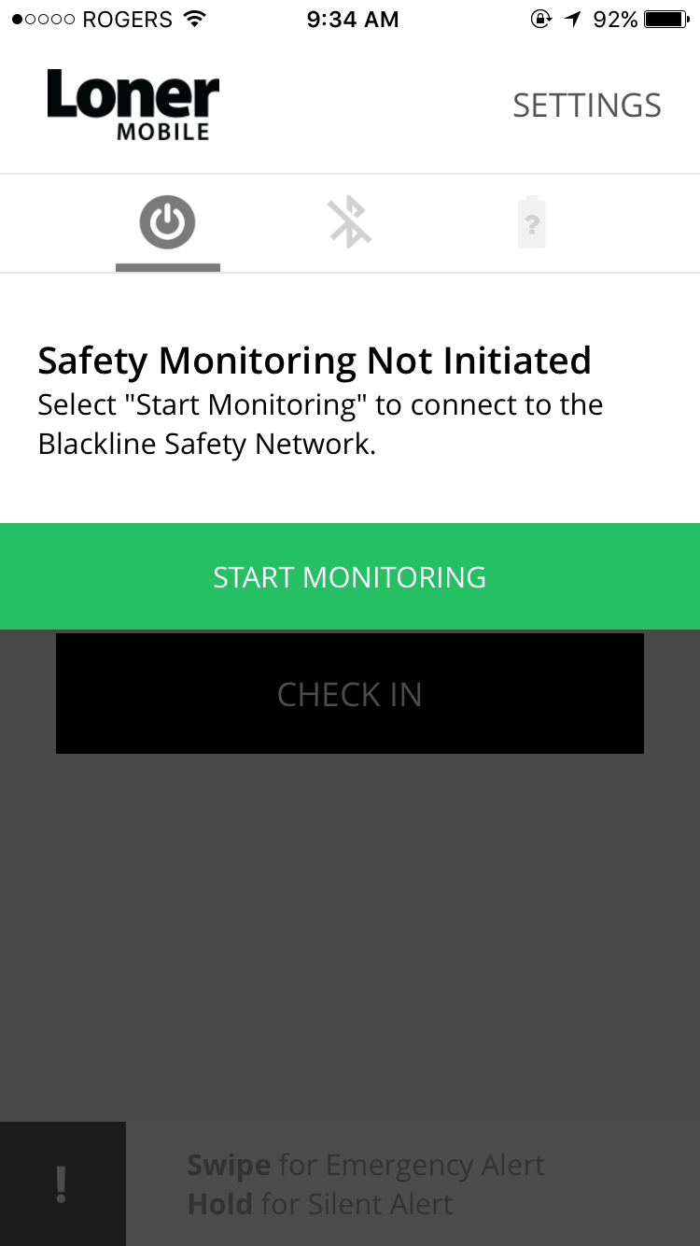
START MONITORING
Press the power button
Press start monitoring
Loner Mobile will begin to Log on to the Blackline Safety Network.
Your safety is now being monitored.

Slide 14
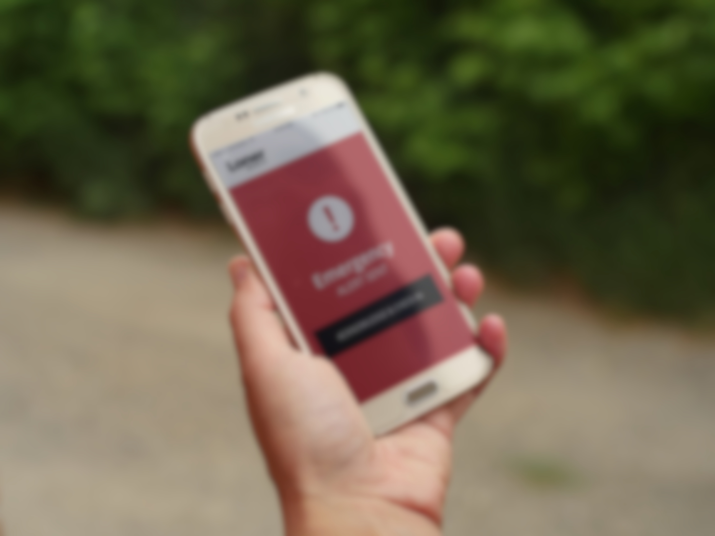
DURING YOUR SHIFT
Notes:
.

Slide 15
AUTOMATIC FEATURES
During your shift, the device may ask you to confirm that you are safe when it detects one of the following:
Check-in
No-motion

Slide 16
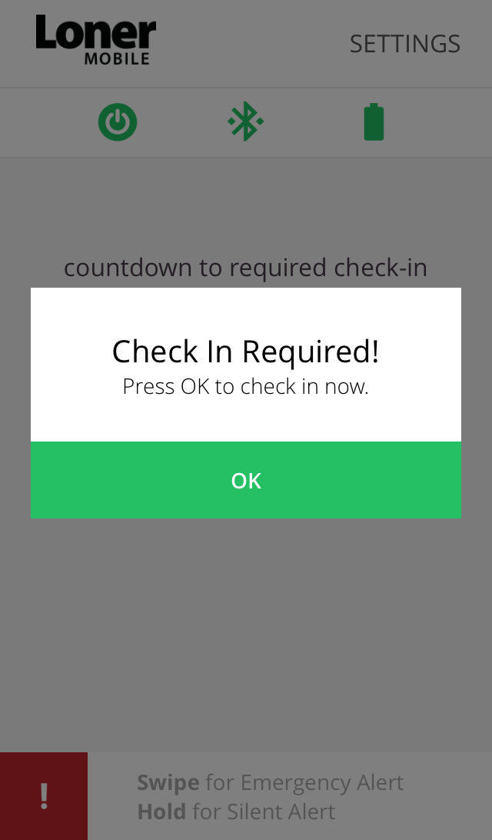
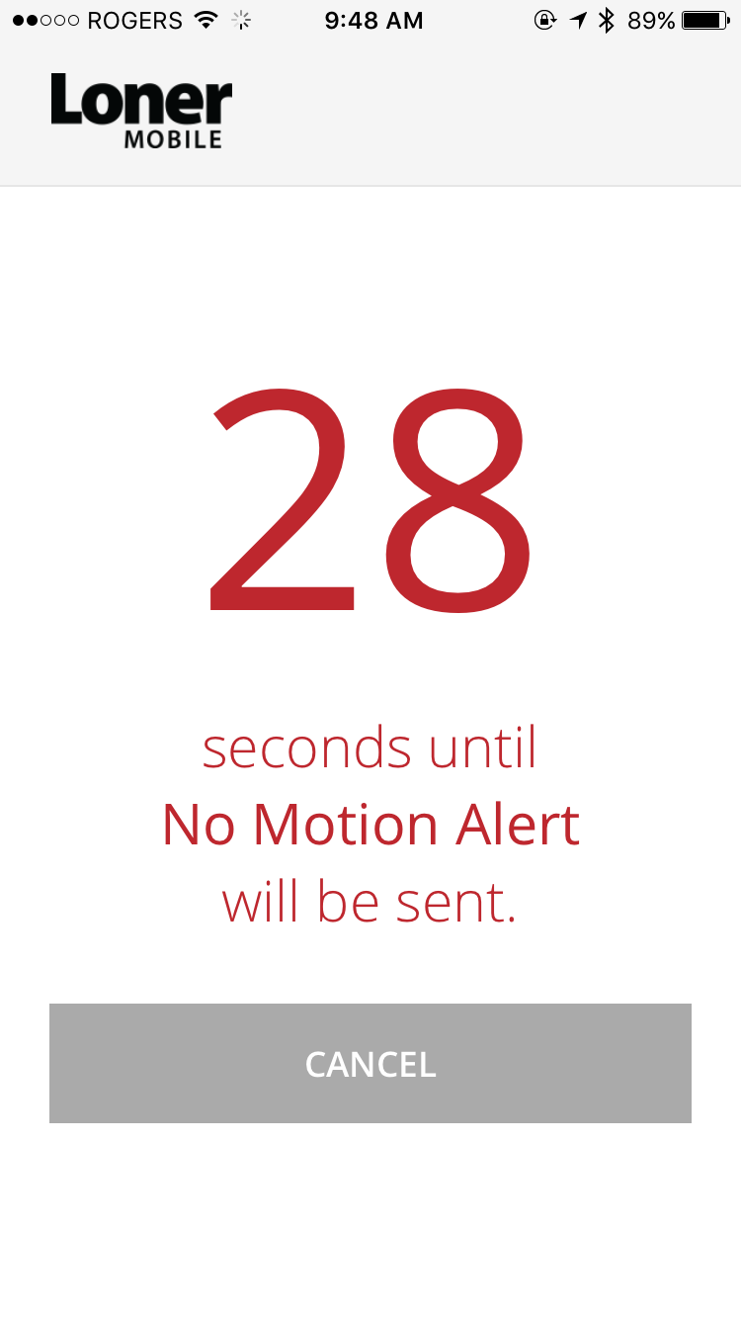

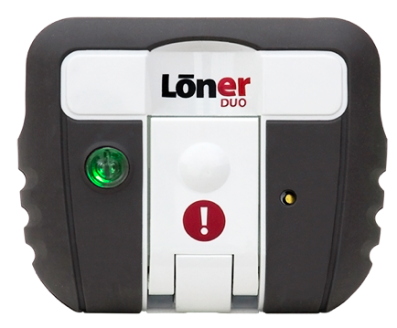
PENDING ALARMS
If your device detects that you have not moved or your check-in timer reaches 0, you have 30 seconds to confirm that you are safe before a red alert is sent to monitoring personnel.
If you are safe, press cancel or OK (for check ins) on Loner Mobile, or press SOS Button or Duo’s latch. This will reset
your check in timer.

Slide 17
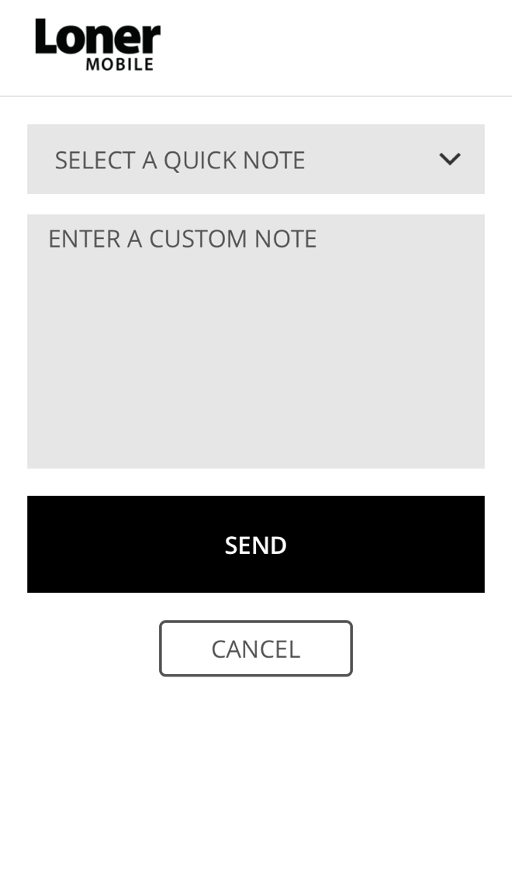
EARLY CHECK-IN
If you wish to avoid a pending alarm, you can check in before it sounds.
Select the check in button
Select a quick note from the list of notes, enter a custom note or check in without sending a note. Loner Mobile’s check-in timer will reset.

Slide 18
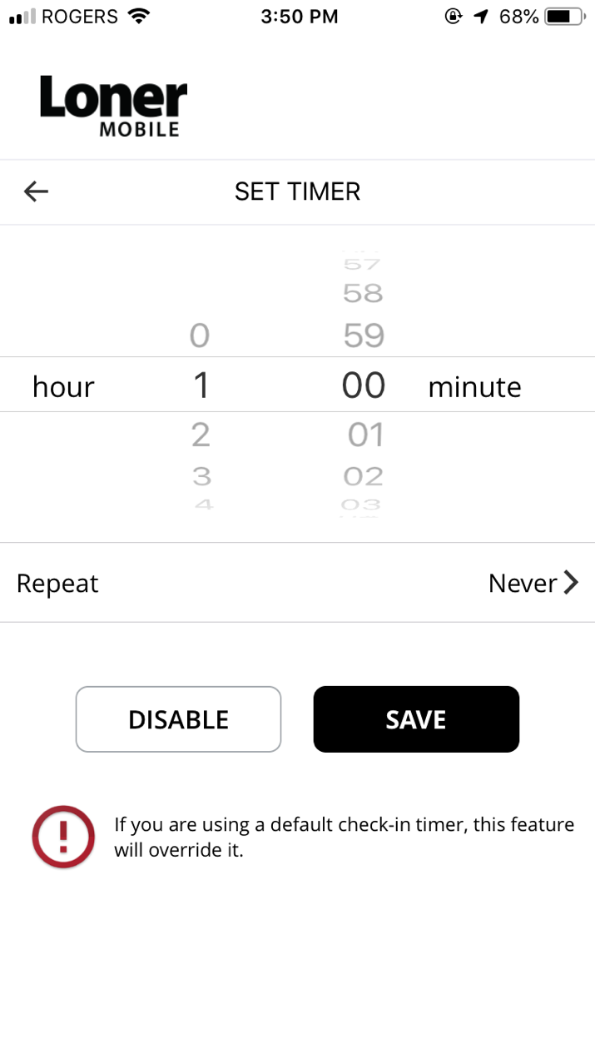
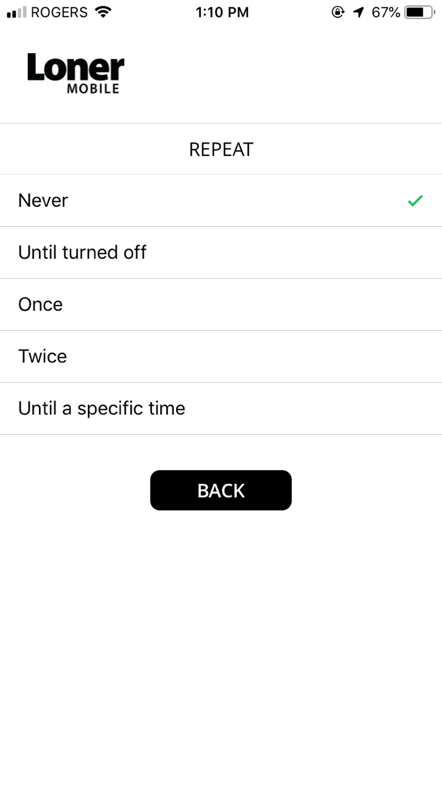
CUSTOMIZING THE CHECK-IN TIMER
If you have permissions to configure Loner Mobile’s settings, you can adjust the check-in timer to only check on you when you need it by selecting change timer from Loner Mobile’s main screen.
Repeat options:
Never - The check-in timer counts down once, then asks the user to confirm safety before turning off.
Once - The check-in timer counts down and confirms the users safety, repeats the cycle once, then turns off.
Twice - The check-in timer counts down and confirms the users safety, repeats the cycle twice, then turns off.
Until turned off - The timer perpetually counts down and confirms safety, until the user manually turns it off.
Until a specific time - The user can set a specific time for the timer to run until, at that time safety is confirmed once more and then the timer shuts of
Choose
time period
Choose repeat
Turn off
check-in timer
Save changes
Note: customizing your timer will override the default set in Loner Mobile’s configuration profile.

Slide 19

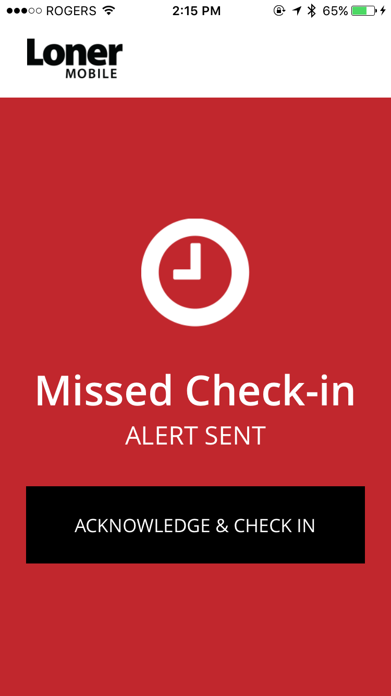
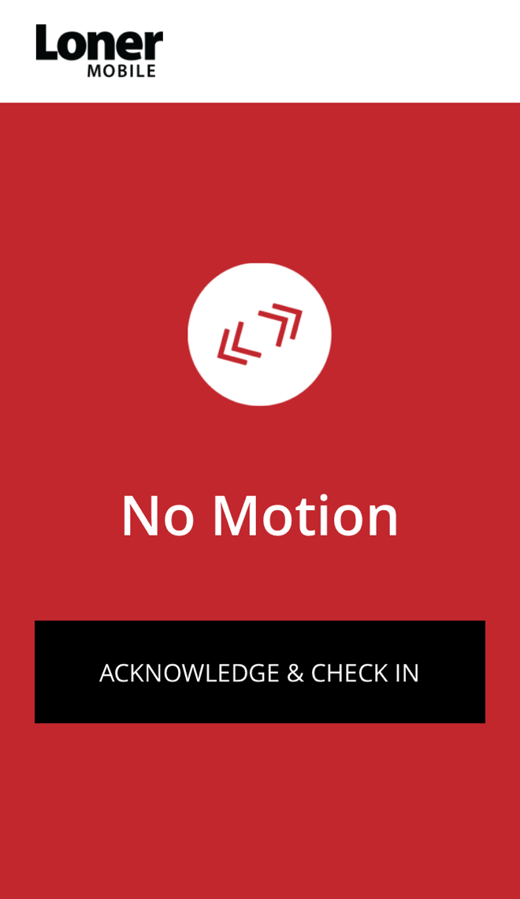
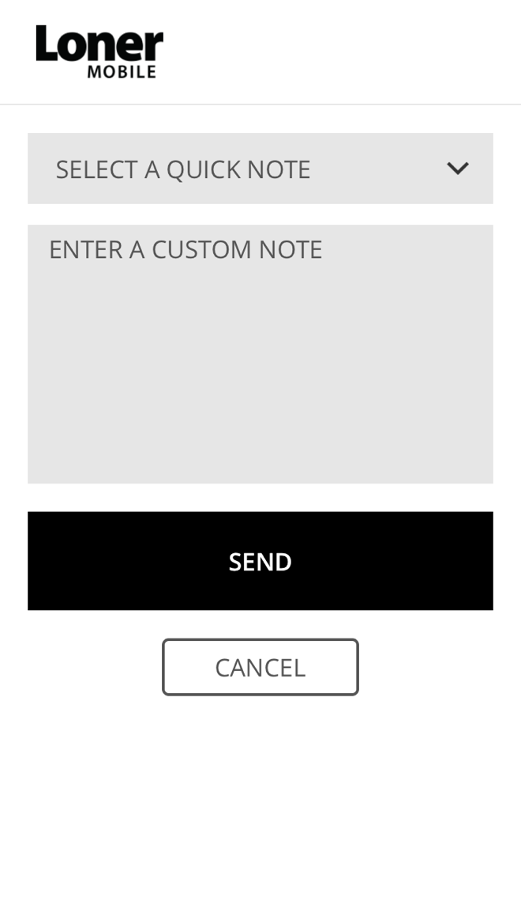

RED ALERTS
If you don’t confirm the pending alarm within the 30 seconds, your device will go into a red alert.
A red alert is immediately communicated to monitoring personnel.
The alert notification remains active and will be addressed by monitoring personnel. Your check-in timer is reset and device returns to normal function
To silence the red alert, select acknowledge & check in on Loner Mobile, or press SOS Button or Loner Duo’s latch. This does not cancel the alert that has been sent to monitoring personnel. They will follow your emergency response protocol to ensure you are OK.
After selecting acknowledge & check in, you can check in with or without a note. This will reset your check-in timer.

Slide 20
MANUAL FEATURES
During your shift, you may need to request help using one of the manual features:
SOS alert
(Audible)
Silent SOS alert

Slide 21
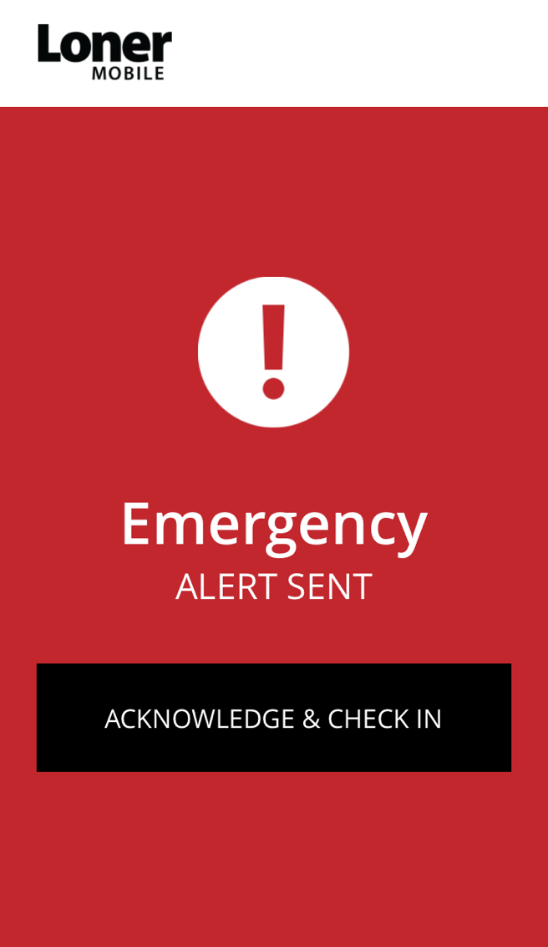
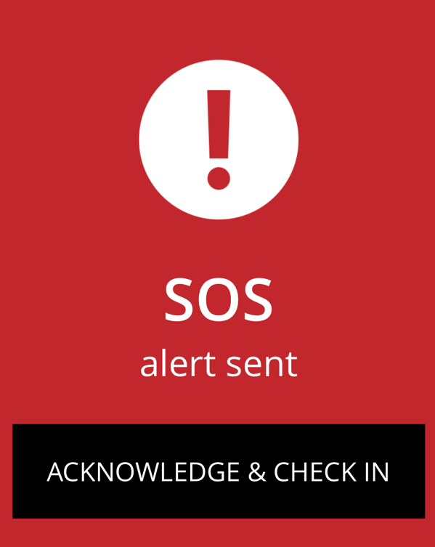
EMERGENCY ALERT
If you need help, you can send an emergency alert to monitoring personnel.
To trigger an emergency alert swipe the bottom slider on Loner Mobile or pull the SOS latch on Loner Duo. Emergency alerts can be sent on SOS Button quickly 3 times, depending on your configuration.
A red alert is sent to monitoring personnel, and your Loner Mobile will sound. If you wish to silence this audible alert, you can press acknowledge & check in. Remember, this does not cancel the alert sent to monitoring personnel.

Slide 22
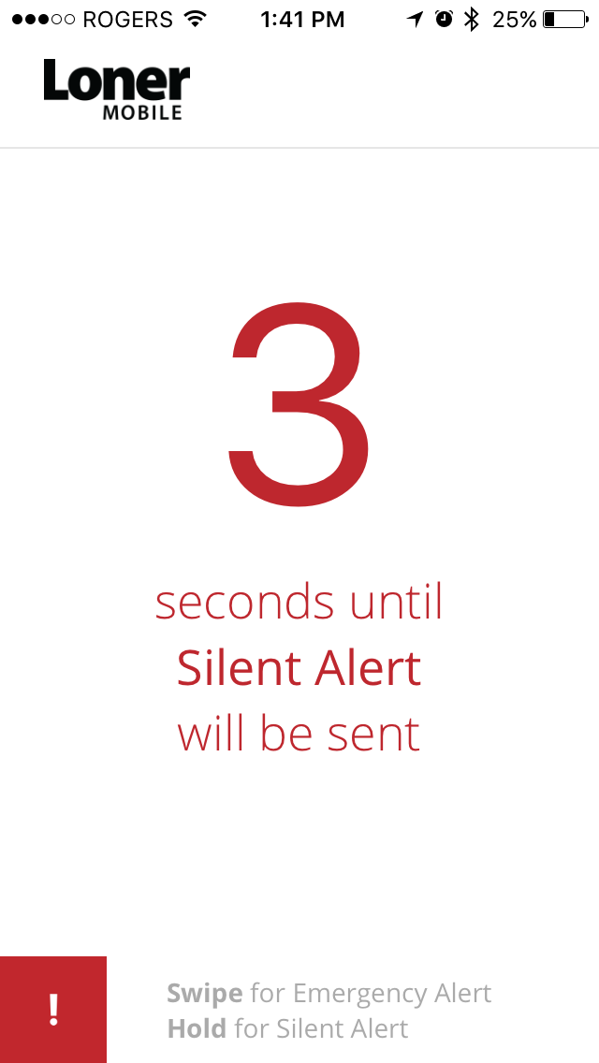
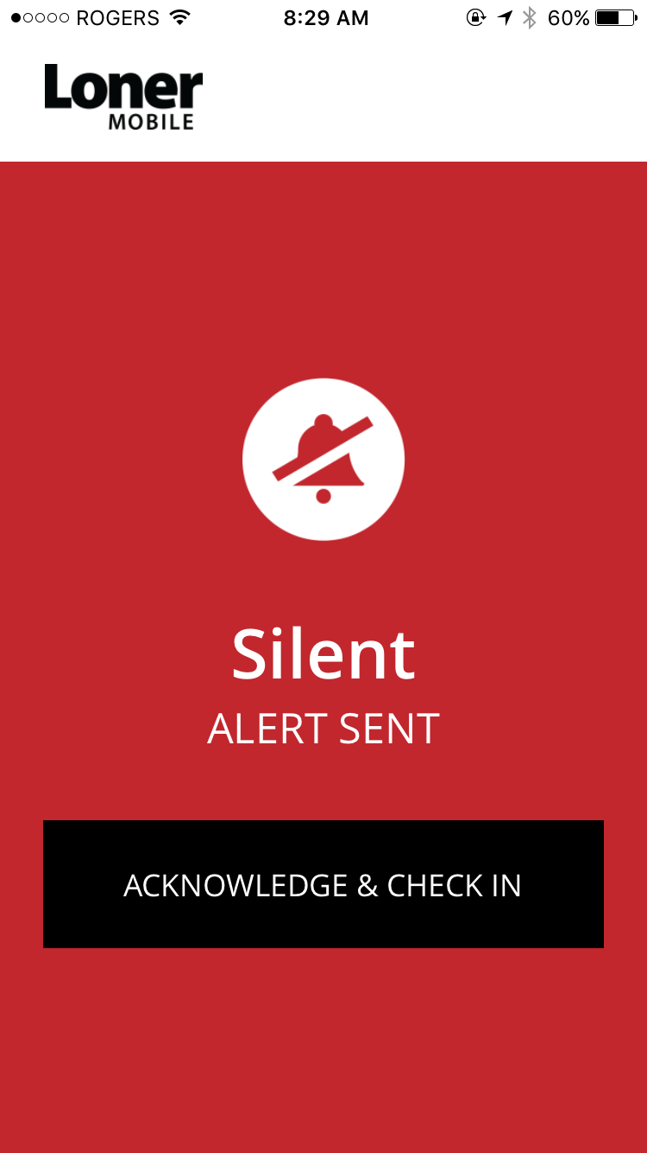
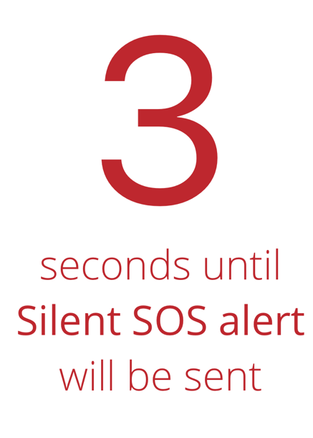
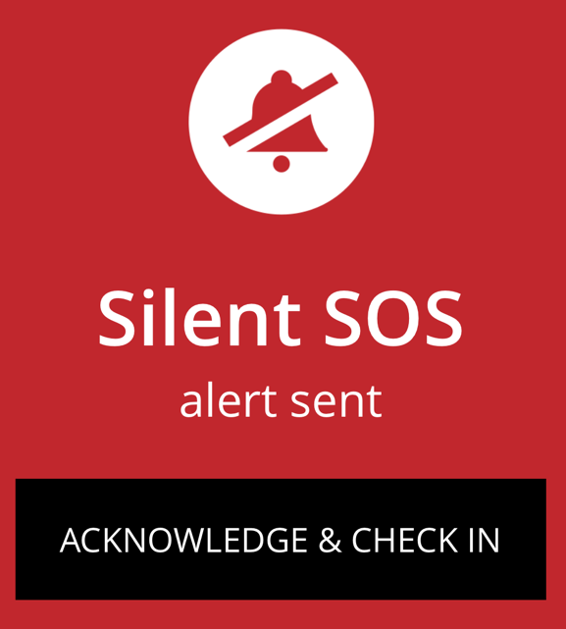
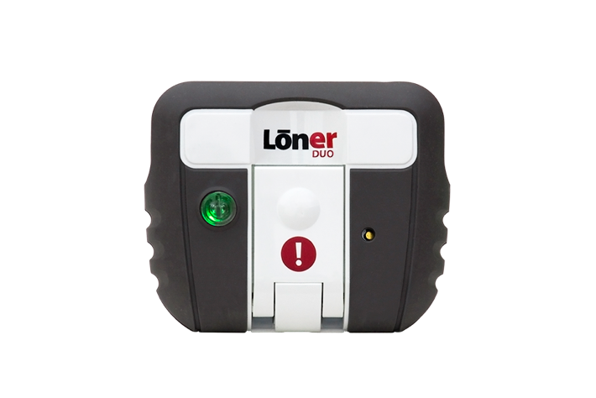
SILENT ALERT
If you need help, but don’t want to notify those around you, you can send a silent alert
to monitoring personnel.
To trigger a silent alert, hold the bottom slider on Loner Mobile, press and hold the SOS latch on Loner Duo, or triple press SOS Button (depending on your configuration)
A red alert is sent to monitoring personnel. If you wish to return to the main screen, you can press acknowledge & check in. Remember, this does not cancel the alert sent to monitoring personnel.

Slide 23
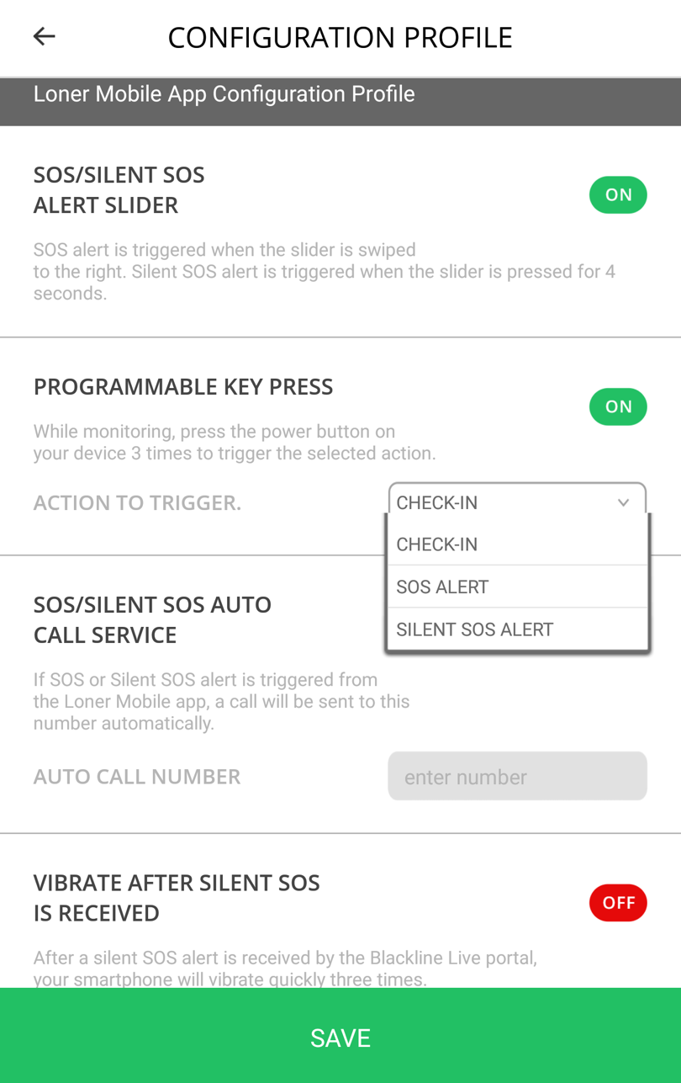
ANDROID ONLY - PROGRAMMABLE KEY PRESS
Check in, send an emergency or silent alert with a triple press of your power button.
In Configuration Profile, turn programmable key press on
From the dropdown menu, select if you want the feature to check in, send an emergency alert or silent alert
Press the power button on your Android three times to trigger your selected feature

Slide 24
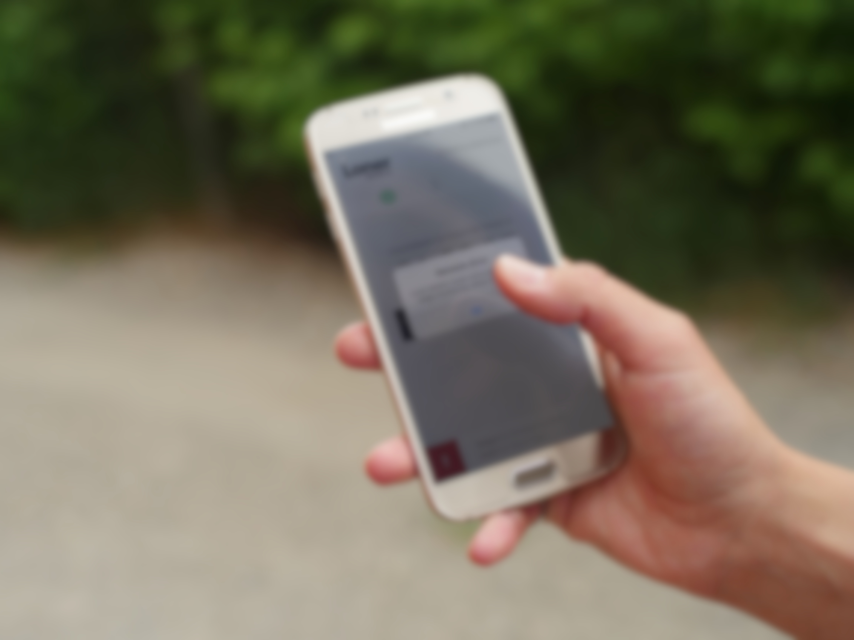
NOTIFICATIONS

Slide 25
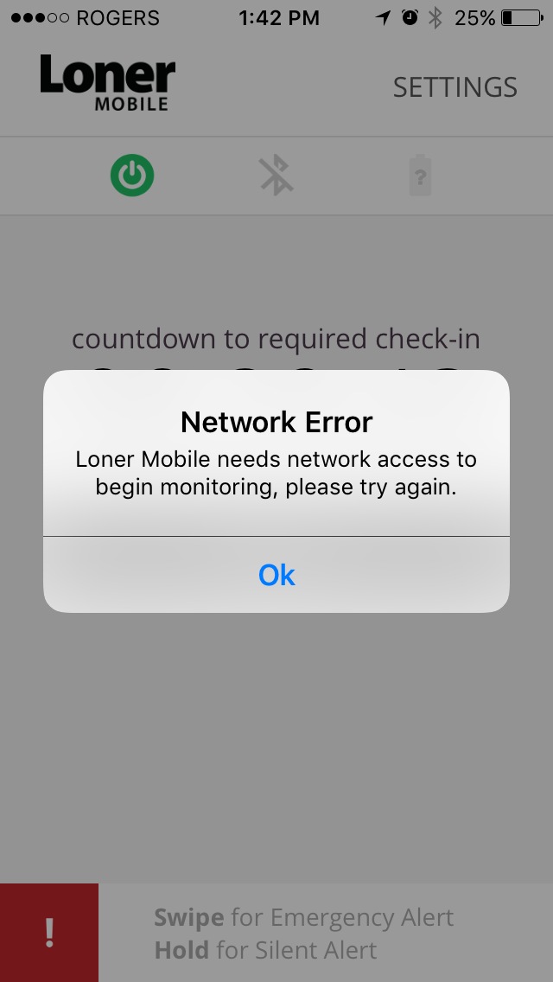
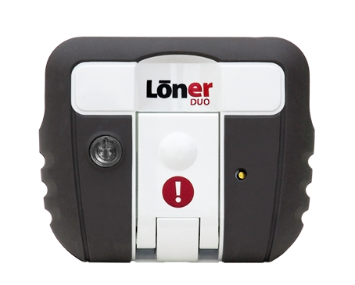

NOTIFICATIONS
Network Error
Low battery
Loner Duo
Loner Duo is configured to signal to you when the battery falls below a certain configured percentage.
Low battery alarm is characterized by a short beep and a quick flash every 5 minutes. Charge Loner Duo as soon as possible.
SOS Button
Loner Mobile’s battery icon’s color will represent SOS Button’s battery life:
Battery life is good
Loner Mobile will notify you if there is a network error. Loner Mobile needs a network connection to monitor your safety.
Battery low, have a CR2032 on hand
Change SOS Button’s battery

Slide 26
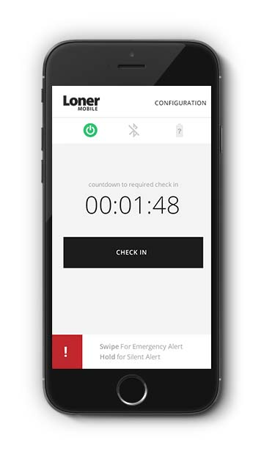
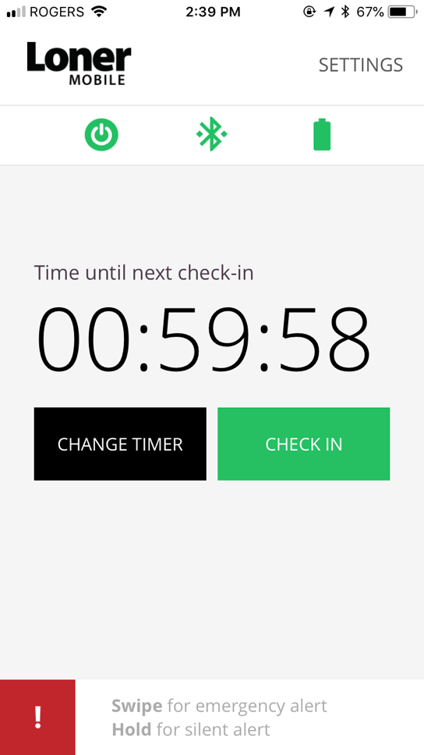
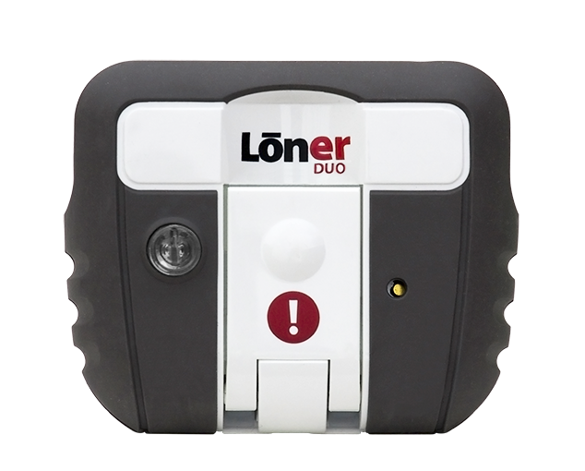
NOTIFICATIONS
Bluetooth Connection
Be sure to keep your device within range of the smartphone.
5 meters or 16 feet
2 meters or 6.5 feet
If your connection is lost
The smartphone will display a notification
Loner Mobile’s Bluetooth and battery icons will be gray
Loner Duo’s SureSafe light will flash green
SOS Button will chirp and flash green

Slide 27
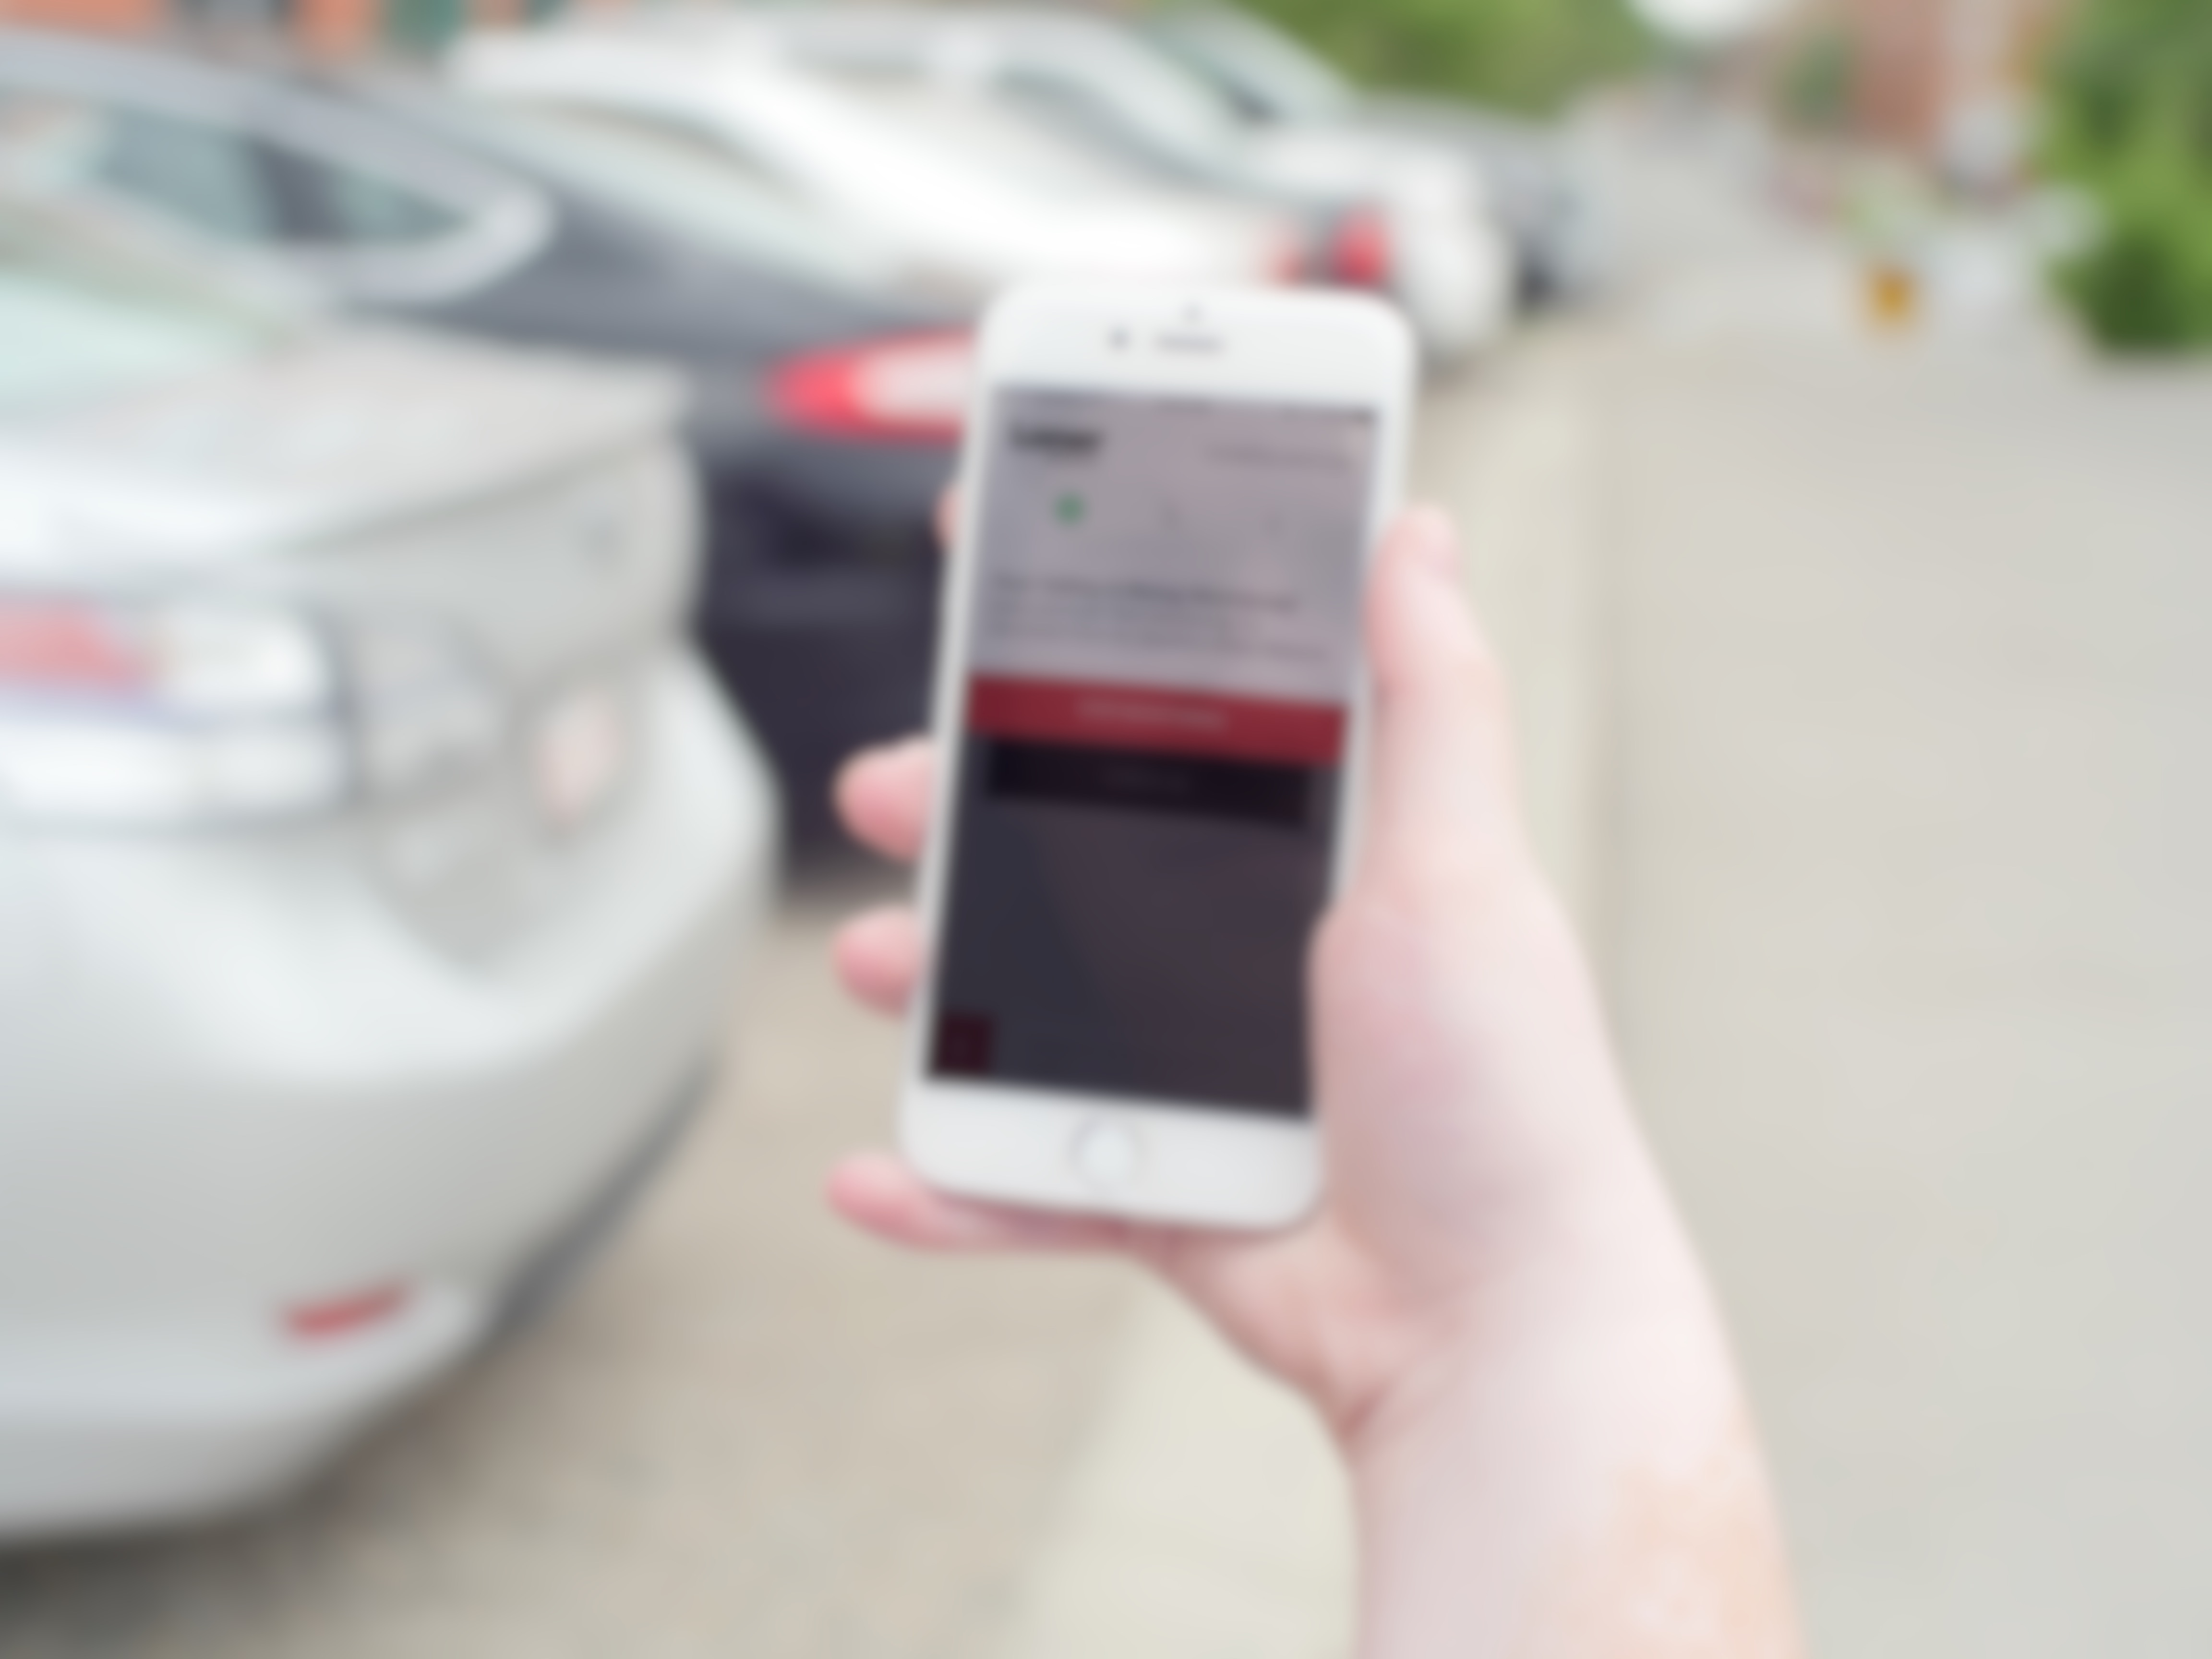
ENDING YOUR SHIFT

Slide 28
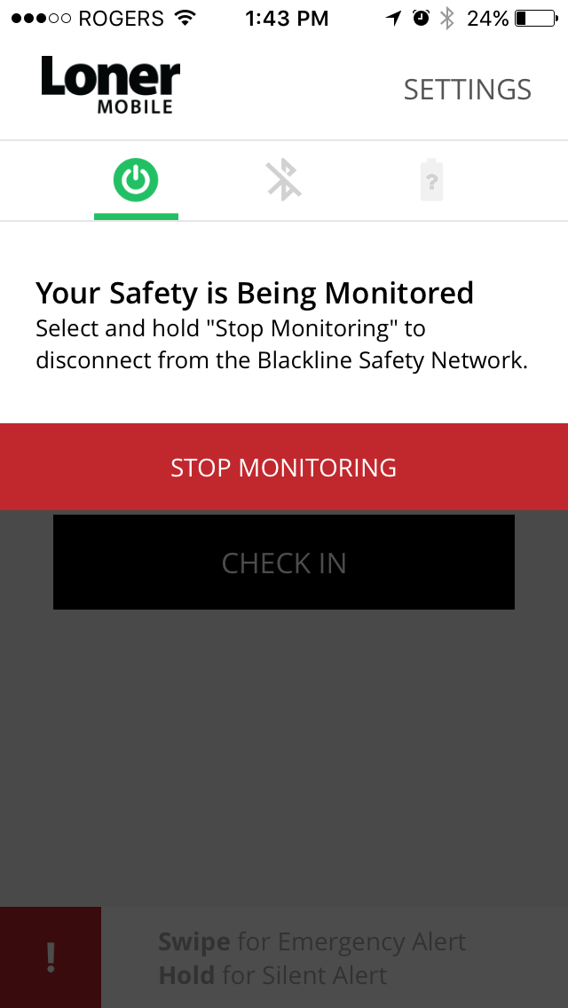
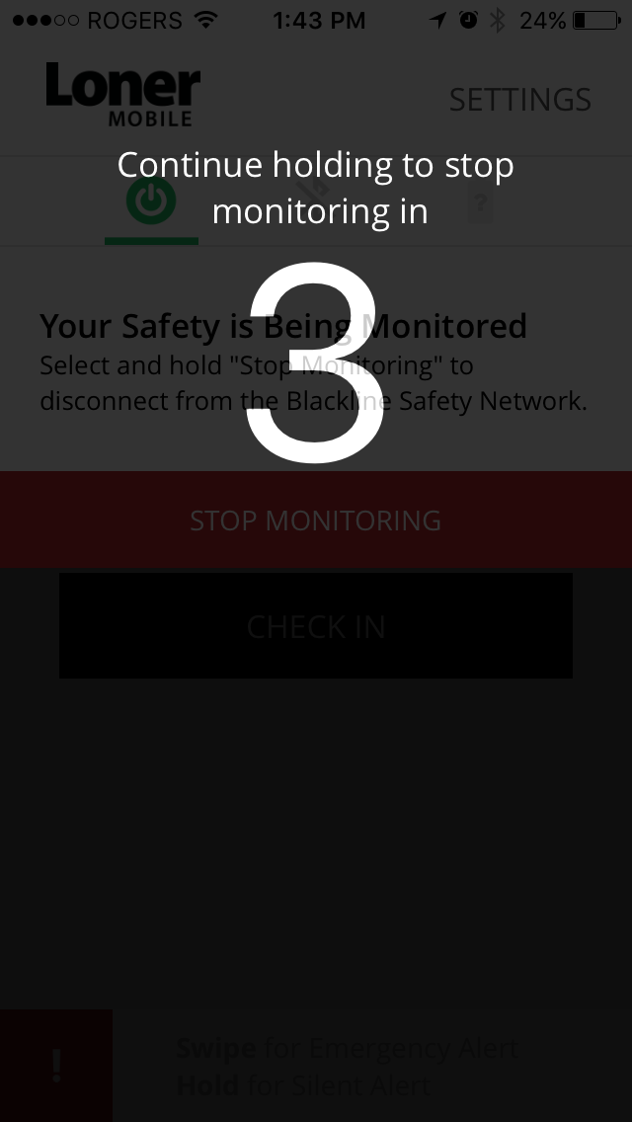
STOP MONITORING
Select the power button
Press and hold stop monitoring for three seconds. Loner Mobile will log off from the Blackline Safety Network.
Your safety is no longer being monitored.

Slide 29

TURNING OFF ACCESSORIES
Loner Duo
SOS Button
Press the power button until beeping and vibration stops (three seconds)
Duo’s SureSafe light will flash and then turn off once it has logged off from the Blackline Safety Network.
If Loner Duo is turned off before you log out of the Loner Mobile, the app will continue to monitor your safety.
Hold SOS Button for 30 seconds. Depending on your audio/visual settings, it will blink red and chirps three times.
If SOS Button is turned off before you log out of Loner Mobile, the app will continue to monitor your safety.

Slide 31

SUPPORT
support.BlacklineSafety.com
CUSTOMER CARE
For technical support, please contact our Customer Care team.
North America (24 hours)
Toll Free: 1-877-869-7212
support@blacklinesafety.com
United Kingdom (8am-5pm GMT)
+44 1787 222684
eusupport@blacklinesafety.com
International (24 hours)
+1-403-452-0327
support@blacklinesafety.com

